Slide 1
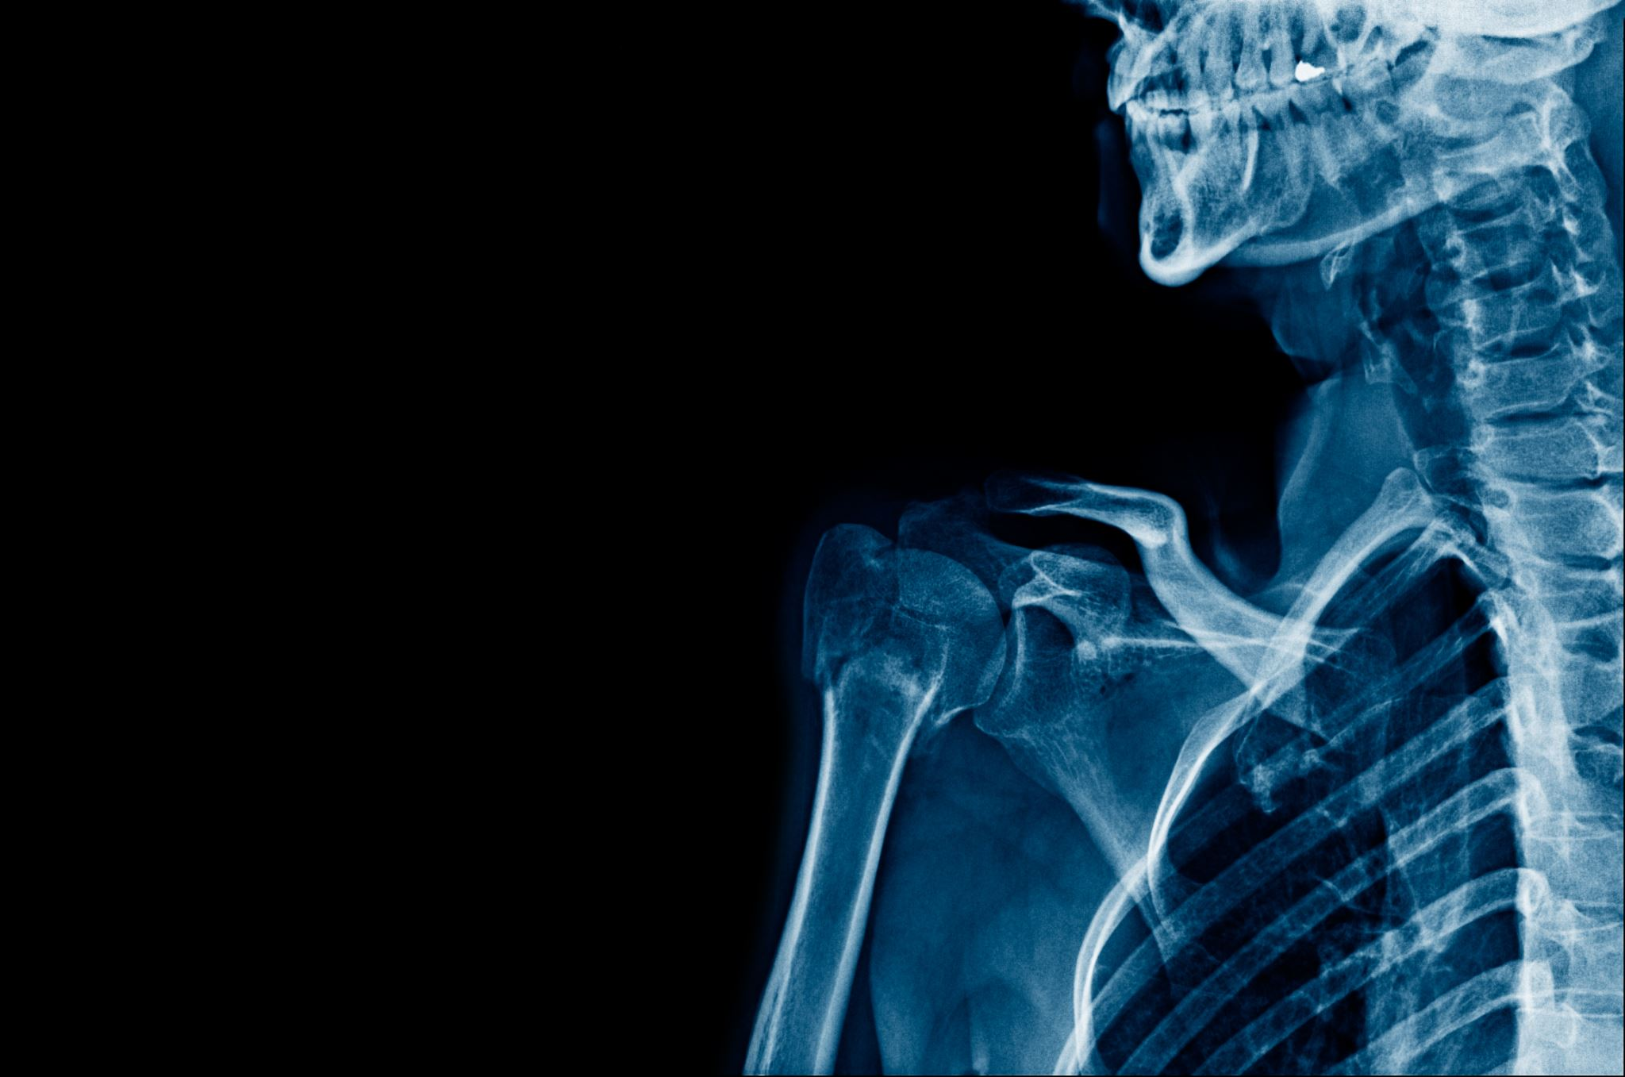
Trauma Informed Techniques
Elizabeth Rogers, M.A.,
Deputy Title IX Coordinator
Kathryn Underwood Smith, JD
Title IX Coordinator

Slide 2
Content Warning
The material in this presentation deals with sexual harassment and sexual misconduct.
Please take care of yourselves as you see fit– there’s no judgement if you need to take a walk, get a drink of water, or go talk to a friend.

Slide 3
Why this Training?
Empathy for those served, for one another, and for oneself can enhance the quality of life for those in law enforcement.
Further, empathy is enhanced through understanding why many people behave as they do, which is a central tenet of being trauma informed.

Slide 4
Agenda
Recognizing Trauma
Trauma informed approach to policing
Additional Considerations

Slide 5
TRAUMA
Defining Trauma
Impact of Trauma
Trauma has profound effects on individuals, often leading to a range of emotional, physical, and psychological symptoms.
Common emotional responses include fear, anxiety, guilt, shame, anger, and sadness.
Physically, trauma can lead to sleep disturbances, headaches, and other stress-related ailments.
Trauma can also impact cognitive and social functioning, affecting memory, concentration, and interpersonal relationships.
Trauma can be broadly defined as an emotional or psychological response to an event or series of events that are shocking, distressing, or harmful.
Trauma can result from various experiences, such as physical or sexual assault, accidents, natural disasters, loss, abuse, or exposure to violence.

Slide 6
Trauma on College Campuses
Prevalence of Trauma
Signs
Trauma is more prevalent on college campuses than one might expect. College students can experience trauma both before and during their time in higher education.
Red Zone
Factors contributing to trauma on campuses may include the high prevalence of sexual assault, hazing incidents, accidents, mental health challenges, and the general transition to college life.
Signs of trauma can manifest in various ways among students, affecting their academic performance, mental health, and social well-being.
Addressing trauma on campuses is crucial not only for the well-being of survivors but also for creating a safe and supportive environment for all students.

Slide 7
Role of Campus Safety and Police
Responsible for maintaining safety and order on campus, conducting investigations, and upholding the law.
What does this look like in action?
Ensuring Physical Safety
Providing a Safe Environment
Empathy and Compassion
Effective Communication
Referral to Support Services

Slide 8
Trauma Informed Principles
Safety
Trustworthiness
Choice
Collaboration
Empowerment

Slide 9
Trauma Informed Principles + Policing
Focus on Understanding: In traditional policing, the emphasis is primarily on law enforcement, investigations, and control. Trauma-informed policing, however, places a strong focus on understanding individuals' experiences and the potential impact of trauma on their behavior.
De-Escalation Over Confrontation: While traditional policing may prioritize confrontation and assertive tactics, trauma-informed policing encourages de-escalation techniques. Officers are trained to defuse potentially volatile situations and prioritize the safety and well-being of all involved parties.
Empathy and Compassion: Trauma-informed policing encourages officers to approach individuals with empathy and compassion. Instead of judgment, officers are trained to provide support and resources for trauma survivors.
Preventing Re-Traumatization: Traditional policing methods can unintentionally re-traumatize individuals, especially survivors of violence or abuse. Trauma-informed policing is dedicated to preventing re-traumatization through sensitivity and understanding.
Holistic Approach: Trauma-informed policing takes a holistic approach to law enforcement, recognizing that social, economic, and environmental factors can contribute to trauma. It considers the root causes of crime and seeks to address them.
Building Trust: Building and maintaining trust with the community is a core component of trauma-informed policing. Traditional policing may prioritize authority and control, while trauma-informed policing recognizes that trust is essential for effective community policing.
Collaboration with Support Services: Trauma-informed policing often involves collaborating with mental health professionals, social workers, and victim advocates. This multidisciplinary approach helps address the complex needs of trauma survivors.

Slide 10
Benefits of Being Trauma Informed
By adopting trauma-informed policing, law enforcement agencies can build stronger relationships with the community, reduce the risk of violent encounters, and contribute to a safer, more supportive environment for all residents.
Additionally, this approach can improve the mental and emotional well-being of police officers by reducing their exposure to high-stress situations and enhancing job satisfaction.
As we move forward, we will delve deeper into the principles and techniques that can be integrated into everyday policing to ensure that trauma survivors receive the care and support they need, contributing to a safer and more compassionate community.

Slide 11
Building Trust
It encourages survivors to report crimes and seek help, which is crucial for their safety and well-being.
It facilitates cooperation and communication, making it easier to gather information and conduct investigations effectively.
It promotes a sense of safety and support, which can aid in the emotional recovery of trauma survivors
Tips:
Empathetic listening
Transparency
Respect boundaries
Cultural competence
Trauma-informed trainings

Slide 12
Communication Techniques
Active listening
Don't interrupt
Empathy
"I can see that this is really hard for you"
validate
Non-judgmental language
Avoid making assumptions
Clarification
Ask open-ended questions
Avoid leading questions
Non-verbal communication
Body language and facial expressions

Slide 13
De-escalation and Crisis Intervention
Importance of being Trauma-Informed
Strategies for Handling Crises
It minimizes the risk of re-traumatizing survivors or exacerbating their emotional distress.
It reduces the potential for violent confrontations and ensures the safety of all parties involved.
It allows officers to build rapport and trust with survivors, improving the chances of successful conflict resolution.
Stay Calm: Maintain your composure, as your demeanor can influence the emotional climate of the situation.
Use Verbal De-escalation: Engage in calm and empathetic verbal communication to soothe heightened emotions.
Respect Personal Space: Avoid crowding or making sudden movements that might increase tension.
Involve a Support Person: If appropriate and possible, involve a support person or a mental health professional to help manage the crisis.
Maintain a Safety Plan: Develop and follow a safety plan that includes protocols for handling crisis situations while ensuring the safety of all involved parties.

Slide 14
Significance of Self-Care for Campus Police Officers
Self-care is essential for the mental and emotional well-being of campus police officers.
It helps officers manage the stress and potential vicarious trauma associated with their roles.
Self-care is not a sign of weakness but a proactive step to ensure officers remain effective and compassionate in their duties.
Resources and Techniques
Peer Support
Mental Health Services
Regular Debriefing
Mindfulness and Stress Reduction Techniques

Slide 15
Importance of Collaboration
Collaborating with other campus support services, such as counseling centers, victim advocates, and mental health professionals, strengthens the response to trauma survivors.
These collaborations ensure a multidisciplinary approach to supporting survivors, addressing their unique needs effectively.
By working together, campus police can provide survivors with a more comprehensive support network, facilitating their recovery and healing process.

Slide 16
Considerations During an Intake of a Report
Mandatory Reporting
Officers should navigate the balance between respecting a survivor's wishes and fulfilling their legal obligations. This can be a delicate process.
***How is this done at Queens?
Trauma-informed officers will explain mandatory reporting requirements to survivors and work to honor their consent and comfort level as much as possible.
Informed Consent
Provide clear information about the process and what is needed.
Respect survivors’ autonomy
Cultural Sensitivity
Officers must be culturally sensitive, recognizing that different communities may have unique perspectives on privacy, confidentiality, and reporting.
Sensitivity to cultural norms and practices is essential for building trust with survivors from diverse backgrounds.
Privacy and Confidentiality
Privacy is a fundamental right of trauma survivors and is essential in creating a trusting environment. Respect privacy
Confidentiality helps survivors share their experiences and cooperate with investigations without fear of retaliation or public exposure.

Slide 17
Practical Skills: Trauma Informed Interview In a trauma-informed interview, questions are asked in ways that are consistent with how traumatic memories are often encoded, stored, and retrieved. Specific techniques include the following: • Sincere efforts to establish trust, rapport and comfort for the victim. • Acknowledgment of the victim’s trauma and/or pain. • Creating an environment that feels physically and emotionally safe for victims. • Communicating in language victims understand and are comfortable with. • Understanding that no one can remember “everything,” at any particular time, so victims are encouraged to relay all the information they are able to at that time. • Use of non-leading questions and other open-ended prompts (e.g., “Tell me more about that,” or “What if anything can you recall thinking/feeling at that point?”). • Encouragement of narrative responses with pauses, and without interruptions. • Focus on what victims can recall thinking and feeling throughout the experience. • Particular emphasis on emotional and sensory experiences (five traditional senses of sight, hearing, touch, taste, and smell, plus internal body sensations). • Expressions of patience, empathy, and understanding throughout the interview

Slide 18
Key Take-Aways
Trauma-informed policing vs traditional policing
Building trust with survivors
Effective communication
De-escaltaiton and crisis intervetnion
Self-care for officers
Collaboration
Legal and Ethical Consideration

Slide 19
Hypothetical
CP & RP meet at a party and realize they live in the same apartment complex. CP & RP each drink about 4-5 drinks over about 4 hours while at the party. When the party ends, RP offers to share an Uber-ride home from downtown. During the Uber-ride, CP & RP kiss. Then, CP texts a friend that CP met a “hot” person at a party and is “totally going to hook up.” Once at the apartment complex, RP asks CP if CP wants to have sex; CP shakes CP’s head up and down and kisses RP. CP & RP walk to RP’s apartment mutually holding hands, and immediately walk to RP’s bedroom. When RP & CP get to the bed, they undress themselves and RP penetrates CP. At the same time, RP begins engaging in “rough sex” (slapping CP). CP was silent during the entire sexual activity, and leaves RP’s apartment afterwards. CP files a Formal Complaint and states that RP “sexually assaulted” CP, explaining that CP was scared and “froze” once the “rough sex” began. CP states “I consented to sex, but not ‘rough sex’.”

Slide 20
Resources
Title IX Office: 704-337-2558, Morrison 200
Campus Safety and Police: 704-337-2306
Health and Wellness: 704-337-2220
QU Counseling Services: 704-337-2556
Chaplain Office (Adrian Bird): 704-337-2290
Rabbi Judy Schindler: 704-337-2507
Safe Alliance HOPELINE: 980-771-4673

Slide 21
Where to Make a Report
Title IX Office
Kathryn Underwood Smith
Director of Title IX and Equity Services
smithk15@queens.edu
704-337-2228
Morrison Hall 200
Elizabeth Rogers
Associate Director for Interpersonal Violence Prevention and Title Response (Deputy Title IX Coordinator)
Rogerse2@queens.edu
704-227-2558
Morrison 206

Slide 22
Thank you!
Any questions? Comments?

